Slide 1

AE Winning Culture 2021
May 2021

Slide 2
Steps Taken
Feedback from all employees
What well went?
What did not go well?
What can we do better?
Survey
Segregation and compilation of all the feedbacks
Created Focus Group of 10 AE Employees
Discussed and brought down 9 AE Culture focus point to 6 AE Winning Culture
Designed Actions and measures for AE Winning Culture
Re-introduce AE Winning Culture and Actions & Measures to Focus Group
Introduction Of AE Winning Culture To AE Team

Slide 3
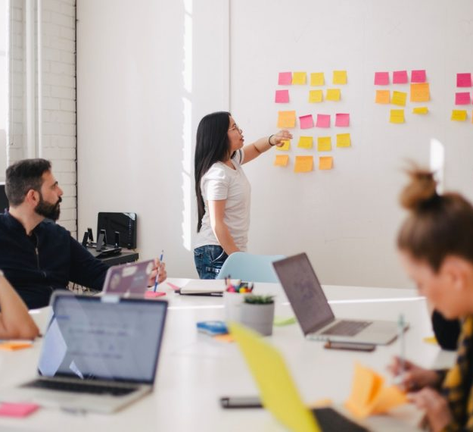
WE COMMUNICATE
Communication is the most important feature in the path of growth. Let’s share our ideas and make AE an open communication forum for all
Actions
Monthly Townhall
Quarterly Go-To-Market Meeting
Newsletter
Measures
10 Townhalls
3 GTM

Slide 4
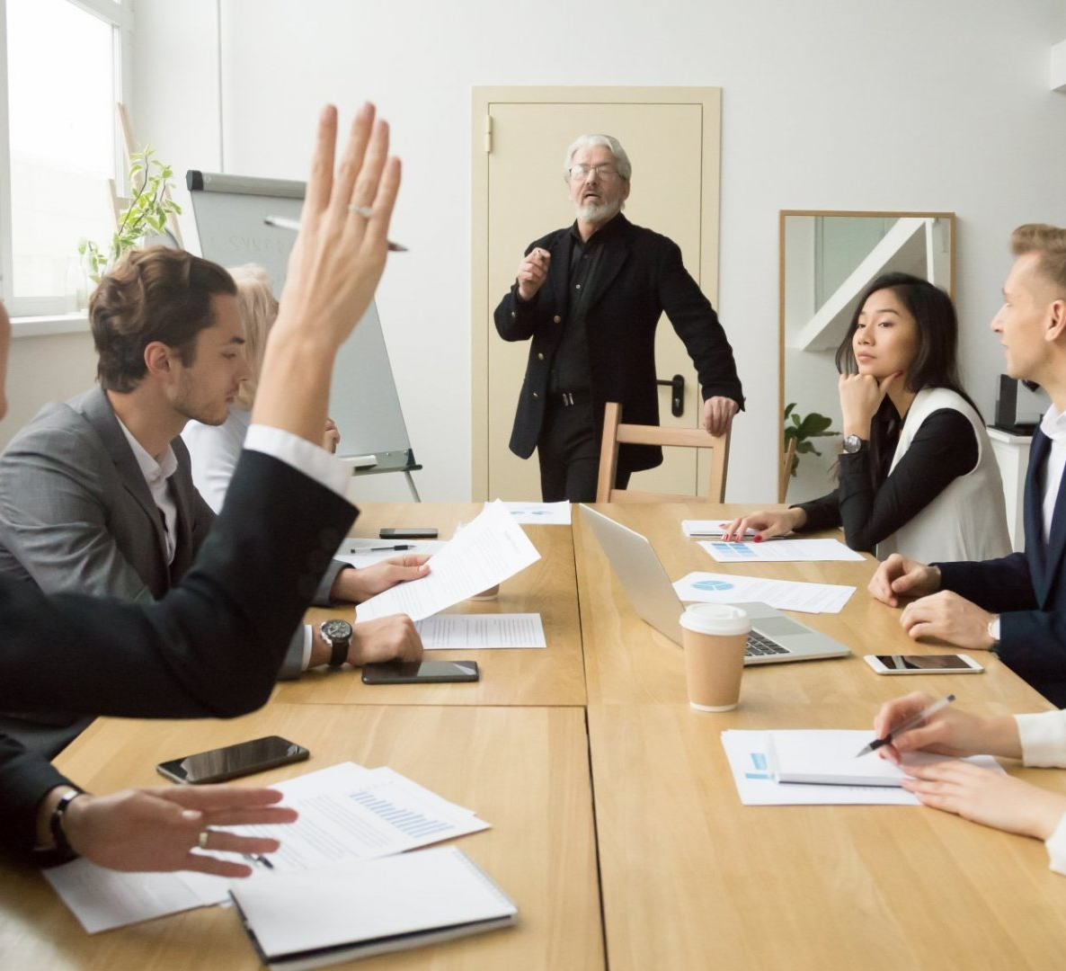
WE LEARN
Learning together is the easiest way for growth. We Teach You, You Teach Us. Together We Learn, Together We Grow
Actions
Market Overview Studies – 6 Trainings on Overview
Specific trainings/ Workshops for groups of 6-7 – Skills wise workshops
Mentorship Program (Reverse mentoring as well)
Measures
6 Trainings on Overview
Specific skills trainings/workshops
Mentorship Feedback

Slide 5

Always On
Starting from being responsible, owning the projects, giving the best ideas to clients, exchanging feedbacks and always being present and active. AE does it all. We are Always On.
Actions
No Multi-tasking at meetings
Critical Project Planning/management
Responsibility and Ownership
Measures
Feedback from peers/clients

Slide 6

Performance Obsessed
Our obsession is Performance & Growth. AE is a place where you can Work hard and Party Harder. We are Performance Obsessed and we love to celebrate our success.
Actions
Annual Offsite
Adopt LFS in everything we do
Client Centricity
Measures
10 Team Engagement
% Rework
Improved Efficiency
Feedback
Innovation & Creativity
Awards & Recognition

Slide 7
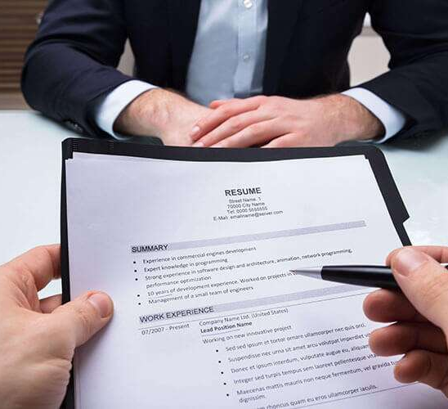
Be Inclusive
Be Inclusive
Different people, different background, various industry experiences & Best Ideas is what AE believes.
Actions
Hire candidates from different genders, educational background and experiences
Measures
Hiring References
Skill Matrix (diversified)

Slide 8

AE Proud
AE Proud
Restructuring & Re-branding. Be Proud of what we all have and are achieving together.
Be proud of us. BE Proud of AE.
Actions
Re-do Website
Participate/host 4+ webinars annually
LinkedIn Participation
Blogs and Articles (Technical/business)
Measures
# of Blogs/Articles generated
Company page stats
LinkedIn likes/shares, etc.

Slide 9

APPENDIX
Video Meeting Etiquette
Time: A minute early
No Multitasking
No mobiles
No background application. Shut off outlook.
Appearance – preferably, if the client has the camera on, so should you.
Use headphones and switch on your lights for video quality.
Dress code – business casual

Slide 10
Thank You

